Slide 1
Open GIS
Chapter - 7

Slide 2
Outlines
What is Open GIS?
Why Use Open Source GIS?
Open GIS Consortium (OGC)
Web GIS
OSS for spatial data analysis

Slide 3

FREE* GIS
*seriously
Notes:
The common misconception with anything free is that there is something wrong with it.

Slide 4











FOSS4G:
Free and Open Source
Software for Geospatial
OSGEO:
The Open Source
Geospatial Foundation

Slide 5
What is Open GIS?
1

Slide 6
What is Open GIS?
Open GIS is the full integration of geospatial data into mainstream information technology.
What does it mean?
GIS users would be able to:
freely exchange data over a range of GIS software systems & networks without having to worry about format conversion or proprietary data types.

Slide 7
What is Open GIS?
Additionally, Open GIS seeks to:
facilitate the exchange of information not only between individual GIS systems but also to other systems.
Like:
  statistical analysis
  image processing
  document management
  visualization

Slide 8
Open GIS Requirements
Interoperable application environment:
a user environment that is configurable to utilize the specific tools and data necessary to solve a problem irrespective of the data structure origin or software.
Shared data space:
a generic data model supporting a variety of analytical and cartographic applications.
Heterogeneous resource browser:
a method for exploring and accessing the information and analytical resources available on a network - this is becoming an especially important goal with the rise of geo-based Internet sites.

Slide 9
Why Use Open Source GIS?
Marketable skills
  In this ever-changing job market it is a huge benefit to be able to bring a total GIS package to the table
Supported by huge development & support community
  Community is very passionate about helping each other but and continually improving software
Low start-up costs
  It is now possible to install a complete GIS stack without paying a cent - LEGALLY

Slide 10
Why Use Open Source GIS?
Security
Arguably more secure than proprietary software
Backed by large development community
Bugs are found and fixed quickly
Works on all major platforms
Complimentary business model vs linear (see next two slides)
There's nothing missing:
Desktop GIS, Spatial Database Storage, Server
Tons of analysis tools (No licensing worries)‏
Community developed add-ons.

Slide 11
Why Use Open Source GIS?
Works with existing GIS data
Import .shp files, most major formats
Export to most major formats
ArcSDE now connects to PostGIS (OS Database)‏
Did I mention FREE?
Potentially save enough money on software to save jobs

Slide 12
Open Source Dev. Model
Org. 1:
Code in
Org. 2:
New feature funders
$$$
Org. 3:
Documentation in, code out
101100011
0110
0110
DOCUMENTATION
011 1001
0110 1100
OS Community
$$$$$$$
0110 0110
Org. 4:
Community-funded
Developers
0110 1100
0110 1100
0110
Org. 5:
Customer of contributor Org.6
0110
0110 110
Org. 6:
Consultant/
Contributor
1010
$$$
0110 1100
$$$
$$$
IDEAS
1010
0110 1100
0100
Org. 7:
Ideas and money in,
code out
0110
Org. 8:
Code and money in,
code and money out
Credit: http://wiki.osgeo.org/wiki/Library Holmes_2006a
Notes:
Holmes_2006a - "Return on investment of Open Source Software / An Ever-increasing Return on Investment", by Chris Holmes; from Location Intelligence 2006; 5 slides [remix: yes] [format: PPT, ODP]

Slide 13
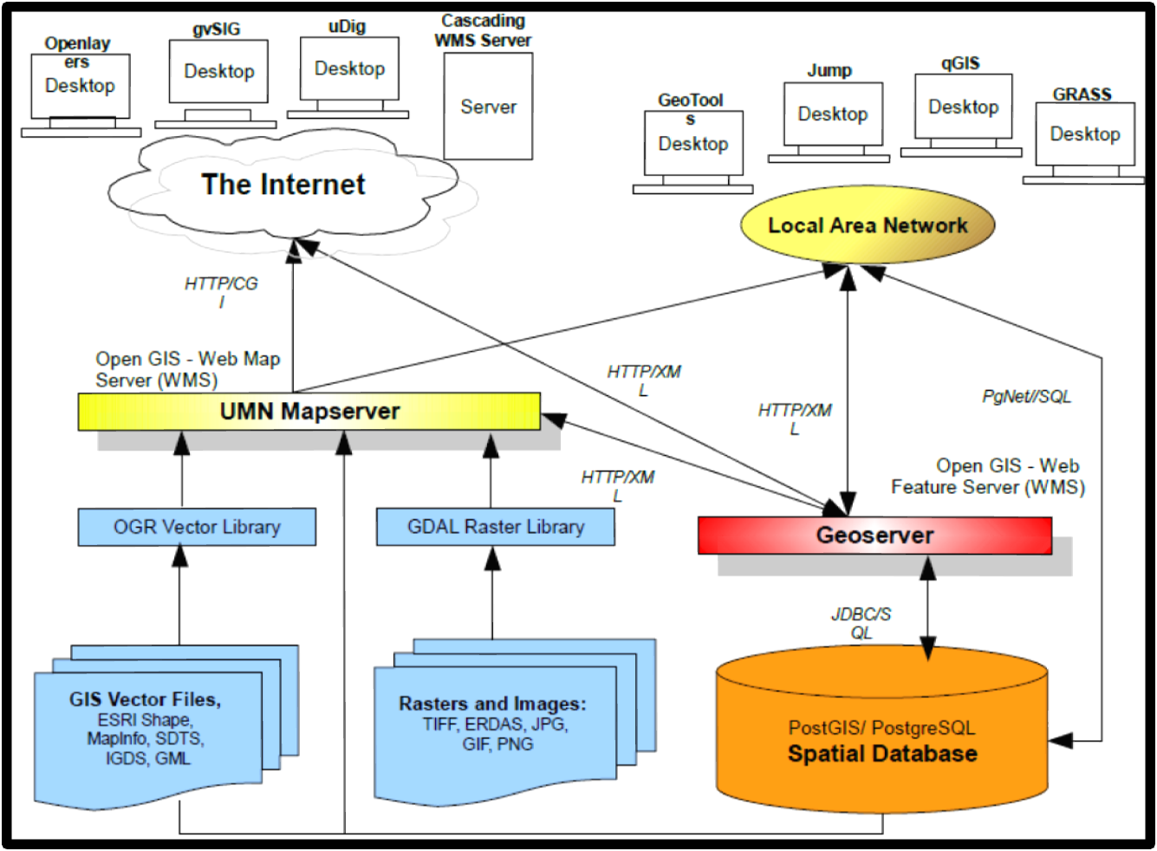
Open Source GIS Domain
Notes:
Holmes_2006a - "Return on investment of Open Source Software / An Ever-increasing Return on Investment", by Chris Holmes; from Location Intelligence 2006; 5 slides [remix: yes] [format: PPT, ODP]

Slide 14
Why Teach Open Source GIS?
Teach fundamentals of spatial data management and analysis rather than button memorization
Becoming an increasingly necessary job skill
Companies with existing GIS are using this software
Makes GIS marketable to smaller firms and non-profits
Drives innovation
Through sharing of knowledge & source code
Code is open and human-readable
Notes:
Imagine if all past knowledge was kept hidden or its use was restricted to only those who are willing to pay for it. Education and research would suffer. Publishing books or sharing information of any sort would become difficult. Yet this is the mentality behind the proprietary software model. In the same way shared knowledge propels the whole of society forward, open technology development can drive innovation for an entire industry.
http://www.redhat.com/about/whyopensource/

Slide 15
Open GIS Consortium
Open GIS Consortium (OGC) was an solution which grew out of the need among federal agencies to share data in the USA.
Open GIS Consortium founded in 1994, but now is known as the Open Geospatial Consortium (OGC)
It is an international voluntary consensus standards organization.

Slide 16
Open GIS Consortium
In the OGC, more than 370+ commercial, governmental, nonprofit and research organizations worldwide collaborate in an open consensus process encouraging development and implementation of standards for geospatial content and services, GIS data processing and data sharing.

Slide 17
OGC Specs: Year of First Approval
Year | OGC Specifications Approval
2004 | OpenGIS Location Services (OpenLS) Specification
2003 | OpenGIS Web Map Context Interface Specification
2002 | OpenGIS Web Feature Service Specification
 | OpenGIS Geography Markup Language Specification (GML 2.1)
 | OpenGIS Styled Layer Descriptor Implementation Specification
2000 | OpenGIS Coordinate Transformation Services Specification
 | OpenGIS Web Map Service Specification
1999 | OpenGIS Grid Coverages Specification
 | OpenGIS Catalog Service Interface Specification
1997 | OpenGIS Simple Features Specification

Slide 18
OGC Standard
Most of the OGC standards are based on a generalized architecture captured in a set of documents collectively called the Abstract Specification.
It describes a basic data model for geographic features to be represented.
The are currently 28 standards in the OGC standards baseline.

Slide 19
Cont. OGC Standard
  OGC Reference Model - a complete set of reference models.
  WMS - Web Map Service: Provides map images.
  WFS - Web Feature Service: For retrieving or altering feature descriptions.
  WCS - Web Coverage Service: Provide coverage objects from a specified region.
  WPS - Web Processing Service: Remote processing service.
  CSW - Web Catalog Service: Access to catalog information.
  SFS - Simple Features - SQL
  GML - Geography Markup Language: XML format for geographical information.
  KML - Keyhole Markup Language: XML-based language schema for expressing geographic annotation(explanation) and visualization on existing or future Web-based, two-dimensional maps and three-dimensional Earth browsers.
  OWS - OGC Web Service Common

Slide 20
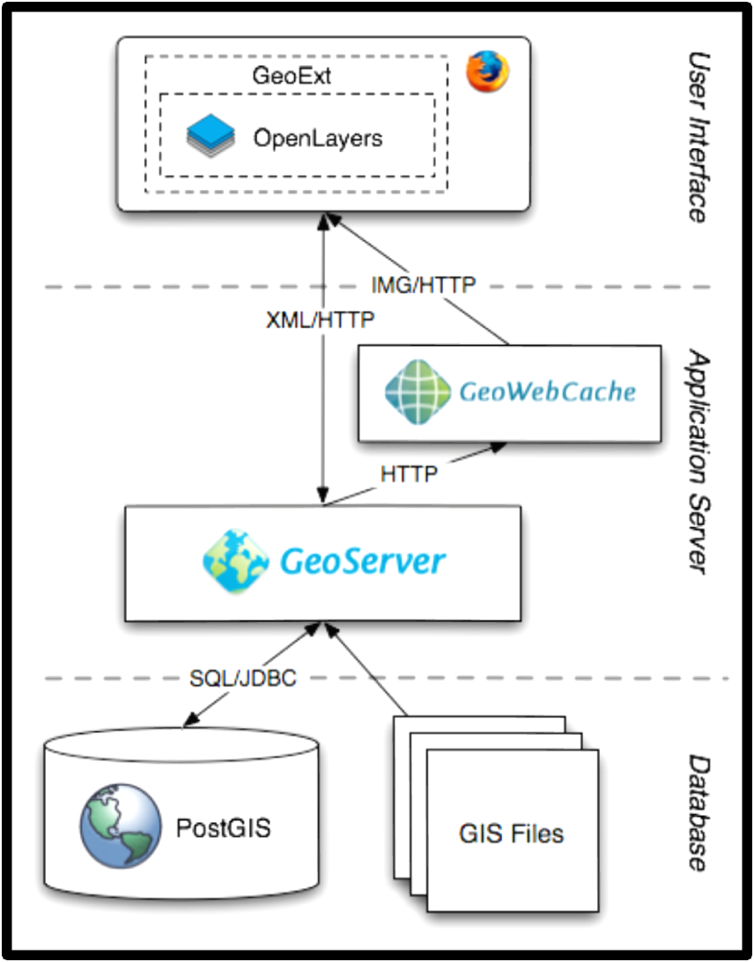
The Stack
..in another form..
Notes:
http://opengeo.org/publications/opengeo-architecture/

Slide 21
Who benefits from Open GIS
The establishment of standards for an Open GIS system will benefit all users of georeferenced data.
Standardization of data structures and processes will help to optimize data exchange between agencies as well as increase the accessibility of GIS to mainstream users.

Slide 22
What is Web GIS?
1

Slide 23
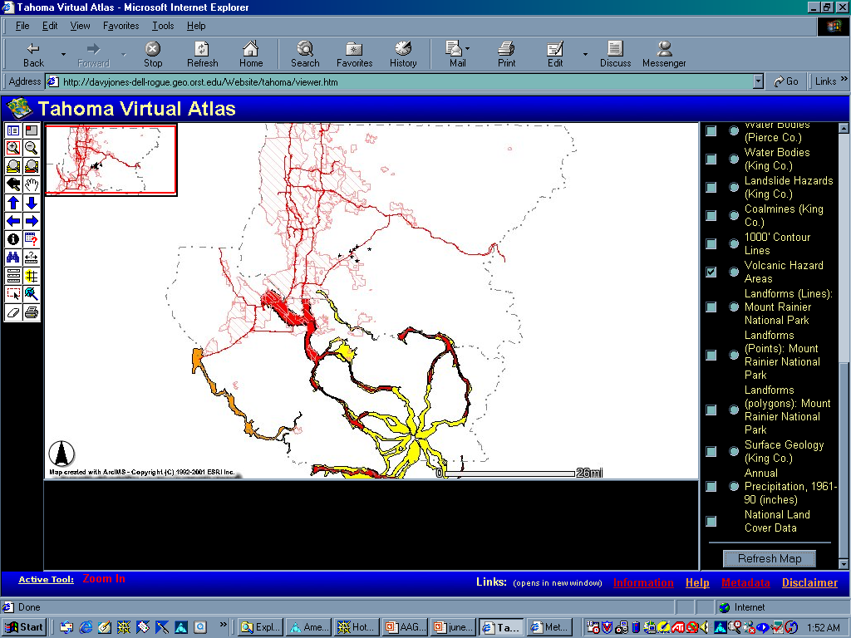
Web GIS
What is web GIS?
Basic GIS functions with Internet technology
Accessible via the Web
Less complex interface
Easier to use as tool
Notes:
Web GIS combines some of the basic capabilities of a GIS with Internet technology.
The user can access a GIS and its data over the Internet, without needing local GIS software or data.
All that is required is a web browser and internet connection.
The interface is less complex than a full GIS: The tools, map, layers, and information are all accessible from a single web page.
What teachers need is a tool that helps them to meet educational standards, instead of a program that requires a lot of class time to teach the technology. I believe web GIS can do this.

Slide 24
Web GIS
Recent technology
  Static maps vs. functionality
Local GIS programs and data not required
Used by GIS novices and experts
Can be tailored to meet needs
Notes:
Web GIS is a fairly recent technology, although the dispersal of geographic data over the internet has been done for awhile in the form of static maps, such as MapQuest or Terraserver, as well as downloadable data that can be used with local GIS programs.
With the development of Web GIS, the internet is becoming more of a portal for GIS functionality as well as data distribution. People can perform basic GIS functions such as having control over what layers they wish to see, as well querying or buffering features in a layer.
Local GIS programs and data are not required, making it easy for a novice or expert to use.
A web GIS site can be tailored to be as simple or complex as the audience needs.

Slide 25
Objectives
Is web GIS a viable option for GIS in education?
What are the benefits and limitations of web GIS use in education?
What are some factors of success?
Notes:
The objectives of my study were to:
1. Determine if web GIS is a viable option for GIS use in secondary education.
2. Determine some of the benefits and limitations of web GIS use in education.
3. Determine some of the factors of success that are needed to make web GIS use a reality in education.

Slide 26
Current Status
2% of schools own a GIS
Only half of those schools use it
Notes:
The current status of GIS use in secondary ed is pretty grim.
Only 2% of high schools own a GIS,
And only HALF of those schools use it.

Slide 27
Why so low?
Full GIS too technical for most teachers
Time consuming:
  Learning
  Teaching (takes away from core curriculum)
Lack of resources
  Training
  Adequate technology
  Money to support these
Few curriculum resources
Notes:
Why are these numbers so low?
A full GIS is to technical for most teachers, and few teachers are willing and able to learn it well enough to teach with it.
A GIS requires a lot of time:
- for teachers to learn well enough to teach,
- It’s also time consuming in the classrooms. **Few teachers are willing to devote so much class time to teaching the technology of GIS that its complexity requires. This takes away from time that must be spent teaching material to meet state education standards.
There is also a lack of various resources.
There are training opportunities available for teachers, but they are few and scattered across the country, and most are too brief for teachers to learn GIS adequately.
In many schools there is also a lack of adequate technology to be able to handle the computer speed and space that a full GIS requires.
Money is also a factor, which is needed to support these, as well as to acquire the software, site license, and data.
Finally, there are few curriculum resources that are available, and those that exist mostly pertain to working with national or global data sets.

Slide 28
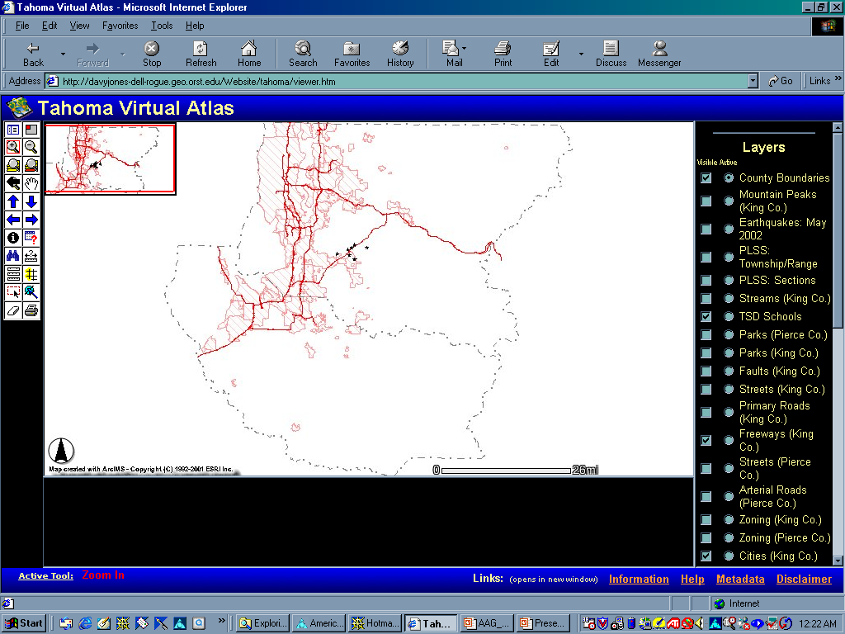
Web GIS
Overview
Map
Layers/
Legend
Toolbar
Map
Frame
Mode Frame
Text Box
Links
Notes:
Here is a page overview of the atlas.
The map frame is where the layers are displayed.
The layers/legend list is where the viewer can control what layers to turn on and off in the map frame, as well as select an active layer.
The overview map shows the area within the atlas extent that the map frame is currently displaying.
The toolbar displays the different functions available to the viewer,
The mode frame states the currently active tool,
And the text box is where tables and forms are displayed.
I added links to the bottom of the page, which go to supplemental pages that I created to help viewers get more information out of the atlas. There is an Information page that describes the atlas, a help page, a link to a metadata index, and a disclaimer.

Slide 29
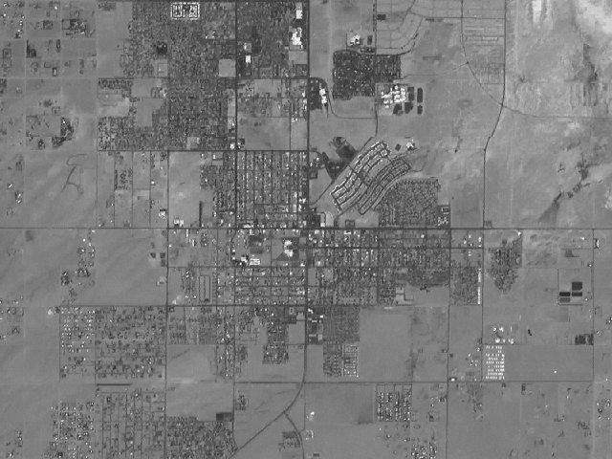
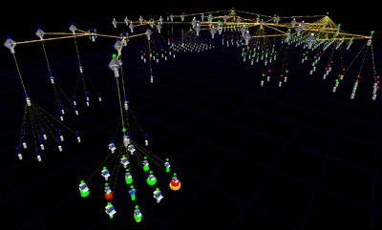
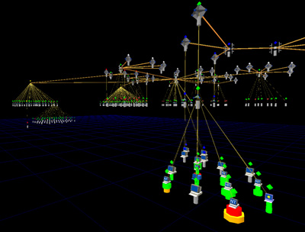
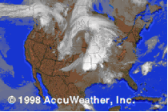
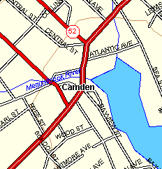
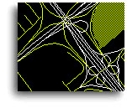
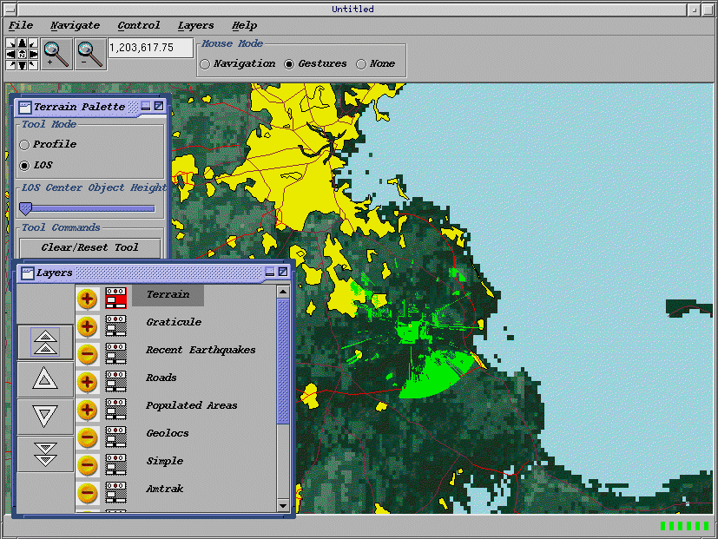
Opportunity in Web-based Mapping
Disaster relief and Emergency management
Global and national geospatial information infrastructures
  Digital Earth, NSDI(National spatial data infrastructure), GSDI-Global
Crime management
Environmental Monitoring
Many others...
World Wide Web
Clients
Internet
Servers
Email
FTP
Notes:
The concept of web based mapping can provide benefit to a wide variety of community applications. Just a few are identified on this slide

Slide 30
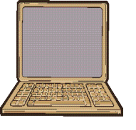
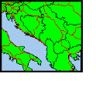
Web servers and map viewer clients interact to -
Web Mapping Defined
Catalog
View
Integrated View
Discover, access and retrieve views from multiple servers
Parcels
Roads
Images
Boundaries
...
Whoville
  Display multiple layers of geographic data within a single web application
Whoville
Cedar Lake
  Query and update
Internet
  Provide interface for visualization, Decision Support, etc.
Environment
Federal
Program
Social
Services
Crime
Support geocoded raster, vector, matrix, and other data
Framework
(Clearinghouse)
Land
Parcel
Weather
Notes:
Here is the Web Mapping vision again, this time with the requirements for WMT I highlighted in blue.

Slide 31
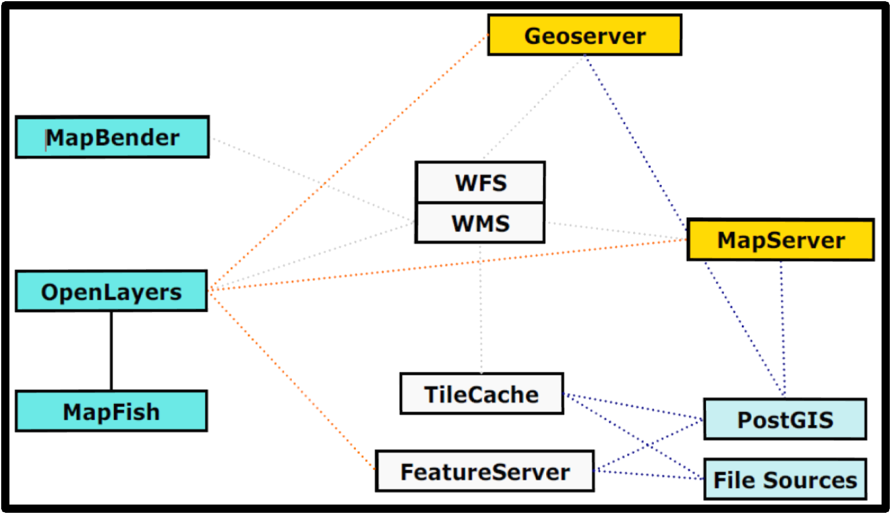
Relation of Web GIS Components

Slide 32
Operational support system (OSS) for Spatial Analysis
Spatial analysis software is software written to enable and facilitate spatial analysis.
Currently, there are several packages, both free software and proprietary software, which cover most of the spatial data infrastructure stack.

Slide 33
OSS for Spatial Analysis
QGIS:
Free: Yes
OS: Linux, MAC OS, Windows
Developer: QGIS Development Team
URL: qgis.org
Field of Interest: Visualization
Main Features: Easy to use, ability to expand functionality with Python plugins. Geoprocessing functions included.
Language: C++
License: GPL

Slide 34
OSS for Spatial Analysis
IL WIS Open:
Free: Yes
OS: Windows
Developer: ITC - Netherlands
URL: www.52north.org
Field of Interest: RS and GIS software which integrates image, vector and thematic data
Main Features: Integrated raster and vector design; image processing tools; Advanced modeling and spatial data analysis; 3D visualization; geo-statistical analyses;
Language: -
License: GPL
Notes:
RS: Remote Sensing

Slide 35
OSS for Spatial Analysis
GRASS:
Free: Yes
OS: Linux, MAC OS, Windows
Developer: GRASS Development Team
URL: http://grass.osgeo.org
Field of Interest: GIS
Main Features: Extensive set of GIS tools for both raster and vector data, SQL, visualization, voxel
Language: C, C++, Python
License: GPL
Notes:
RS: Remote Sensing

Slide 36
OSS for Spatial Analysis
R:
Free: Yes
OS: Linux, MAC OS, Windows
Developer: Roger Bivand (maintainer)
URL: http://cran.r-project.org
Field of Interest: Analysis
Main Features: classes for spatial data; handling spatial data; reading and writing spatial data; point pattern analysis; geostatistics; disease mapping and areal data analysis; spatial regression and ecological analysis
Language: R
License: GPL-2
Notes:
RS: Remote Sensing

Slide 37
Assignment
Write answers to all the old questions --Repeated question can be escaped.-----Dead line
2075-08-28
Must be hand-written not digital copy.
Write a page about FOSS-Free and open source software for GIS

